Slide 1
Change Analyst - Cornwall Council
Scope of this presentation: This presentation aims at elaborating my knowledge of the requirements specified in the job specification.

Slide 2
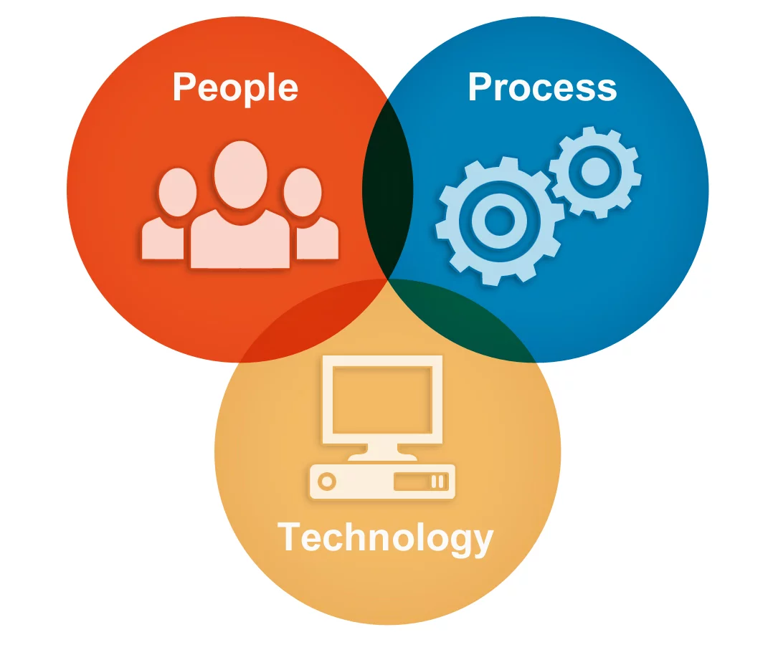
1) Assessing business impacts of the upgrade on existing process, policies, roles etc.
I approached business impacts on a similar project at Barclaycard. The last highlight of NFRs and Support Model was accomplished while at Barclays Wealth.
As a Change Analyst, understand the business change of moving from existing ERP Finance systems and detailed specifics of how and when Cornwall Coucil intends to transform itself to Oracle Cloud.
Elaborate businesss impacts of the upgrade by linking the 3 very inter-related but unique entities of People, Process and Technology.
Elaborate detailed business design that includes:
Existing business process flows
Business process flows on upgrade to cloud based
Process descriptions
Service Level Agreements
Roles & Responsibilities
Elaborate internal and external dependencies establishing relationships between Cornwall Council and the 3rd party vendors and business partners.
Elaborate concepts that need to be run past legal teams at Cornwall to ensure adhere to legal and regulatory compliance.
Elaborate interaction and message/data flows between various systems and applications required for the upgrade.
Elaborate Non-Functional Requirements & Support Model elaborating system concepts and how the upgrade shall be supported on go-live.

Slide 3
2) Stakeholder management & engagement
While working on Banking projects, I accomplished stakeholder management and engagement as below. First of the two highlights below was accomplished while at RBS and the 3rd highlight was accomplished while at Tesco Bank.
Produce stakeholder maps as an L1 gathering names of all the stakeholders and their position within the business.
Elaborate stake of various business units in relation to this business change of moving from existing Finance ERP systems. In other words, responsibilities of various business units in transforming to Oracle Cloud.
RACI elaborating responibilities of stakeholders within each business unit. In other words, stakeholders who are to be responsible, accountable, consulted and informed for the successful implementaiton of this business change.

Slide 4
3) Shaping of communications
Of the 3 highlights below, RACI was the approach to shaping communications while at Tesco Bank and the 2nd and 3rd highlights were from while at Barclaycard.
Ensure stakeholders with varying responsibilities are kept informed accurately as per baselined RACI document.
Ensure only appropriate level of information is shared with 3rd party vendors and business partners in adherence with any non-disclosure agreements.
Keeping pace with other company wide communications and how that might impact our project.

Slide 5
4) Inputting into training design
I was involved in inputting to training design team while at BSkyB. The Training design team was called Business Readiness Team.
My inputs to business readiness and training design were as follows:-
Screen grabs of CRM solution
Screen validations including button clicks and field tab outs
Feild validations
The above fed in to the training manual that was produced by the business readiness team to train Call Center agents who would transform themselves to answering customer calls using the Web CRM solution built for business customers of Sky.

Slide 6
5) Attending programme workshops as a representative of the Change team.
I have attended Requirements workshop while on all of the projects since 2008/09.
Outcome from workshops usually have been:
Draft documents for review
Draft documents reviewed, updated and baselined

Slide 7
6) Awareness of change management methodology
Been on change initiatives and impacts were assessed bringing the 3 entities of people process and technology.
This includes all of the projects in my CV since 2008/09.

Slide 8
7) Knowledge of ERP Finance systems or similar and Oracle Cloud.
Fourth Hospitality was one of the clients who moved to Oracle Cloud based environment. I worked for Fourth back in 2014/15 with a view to enable clients with easier access to all of Fourth applications.
The project I worked on authenticated Fourth clients via single sign-on enabling access as per their role and access rights defined.

Slide 9
8) Initial thoughts on relocate/travel (To be reviewed by Logix Resourcing and Cornwall)
Initial thoughts:
Limited Company is registered in Scotland. I thought of the following solutions when I did more research about Truro and Cornwall and understood Cornwall Newquay is the nearest airport.
Solution 1: Relocating to Truro, Cornwall for the duration of the assignment.
Solution 2: Traveling to Truro, Cornwall from Burntisland.
Proposal to be reviewed by Logix Resourcing and the client Cornwall Council:
After a bit more detail and understanding of what both of the above options meant in reality that includes flights/trains/taxis, I thought of proposing an idea of traveling back to the base location once in every 3 weeks.
I'm willing to be flexible based on the project needs as this is only an initial thought.

Slide 10
Interview questions & My responses
1) What interested you towards this position?
The fact that it is a change analysis position involving detailed business design and business impacts interested me. Moving to Oracle cloud came across as a technical project and fact that I'm from a technical development background was of interest.
2) Examples where I had been involved in organizational change projects in the past?
At RBS on 2 organizational change projects replacing the authentication mechanism from Card-readers to One Time Passcode and Paperless Office Secure Messaging.
3) What were my inputs on the organizational change projects?
At RBS, I produced Stakeholder Maps, participated in requirements workshops, fed inputs to Terms of Reference and Business Operating Model. Elaborated User Experience design screens.
4) Have I ever been involved in a project that involved Financial Processes?
No, I have not worked on a module that involved billing and Financials on the process. I have worked closely with a BA from Billing Stream to produce the screens and have a good understanding of billing and Financials.
5) How would I go about a workshop?
Preparing from existing sources like outdated documentation, URLs or access to play around with existing systems &
Having a good understanding of what we want out of the workshops. In other words setting the agenda as we may or may not be able to solve all the problems in the workshop itself.
6) What would I class as a good requirements workshop?
A workshop for which the organizers were prepared well with the technical information and the stakeholders had a good understanding of what we want out of the workshop itself.

Slide 11
Interview questions
7) What were my experiences with stakeholders and managing stakeholders on projects?
Elaborating stake of a business stakeholder from various business units/functions and having it reviewed to confirm they are happy with their stake and responsibilities on the project.
8) How would I go about stakeholders who didn't have much to say during workshops how would I bring them on-board?
1-1 interviews after the workshop to understand their inputs and how well they appreciate the change and moving to new systems elaborating any pros and cons.
9) What are my inputs to who is going to receive the end result of the project. In other words, my inputs to end users of the solution? Were they happy and would you do anything different?
In the CRM project I worked on, the team was called business readiness team elaborating the training manual for call center agents. My inputs were screen shots from test environments and for screens that are not yet complete, User Experience mock-ups to assist the business readiness team in elaborating their training manual.
As there were a few subject matter experts o the CRM project who went back to customer services leading a team of call center agents, they seemed happy with training design and the CRM. I actually didn't meet the call center agents. So not too very sure.

